Slide 2
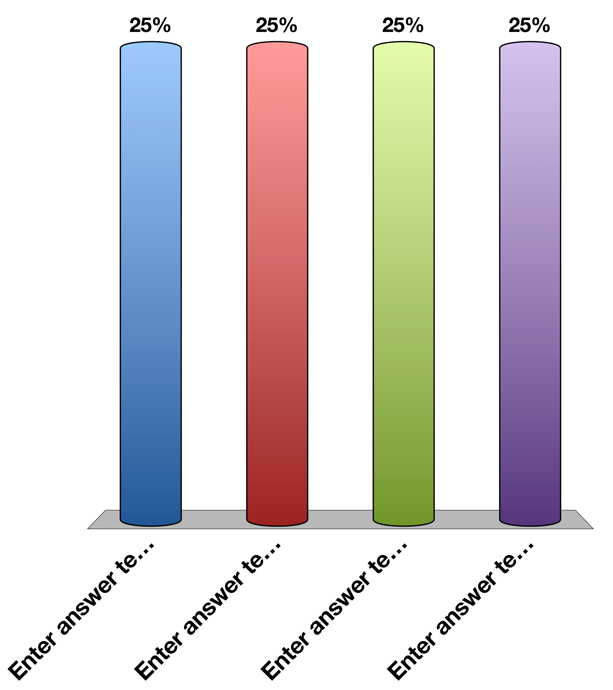
Clicker Check: Press A
A
B
C
D

Slide 3
A patient has a pheochromocytoma, we expect that this the patient should have:
Tachycardia
Reduced gluconeogenesis
Reduced lipolysis
Increased salt retention

